Slide 1


Slide 2
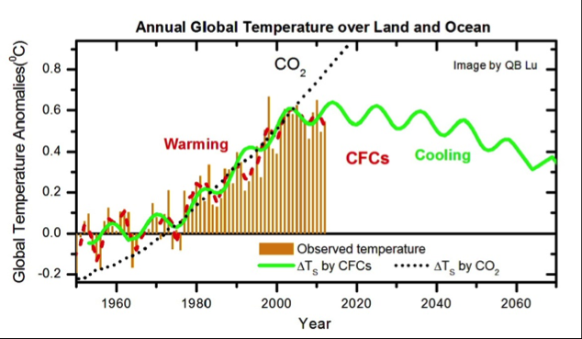
Example of Dynamics

Slide 3
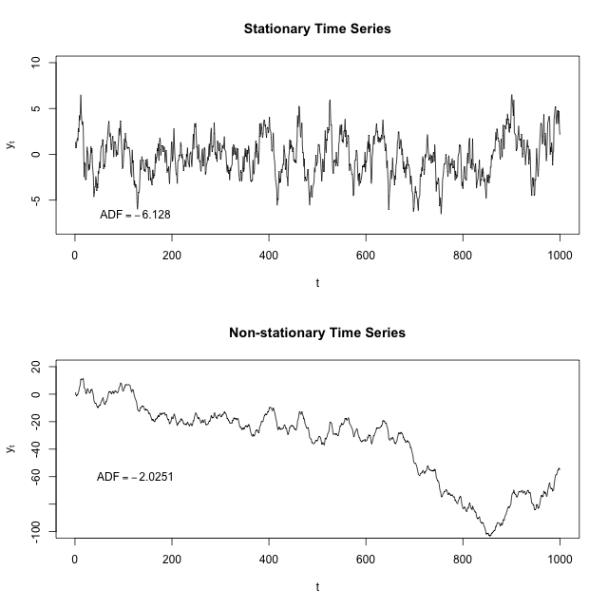
Time Series
Vikas Agrawal
Oracle Corporation
All Forecasts Are Wrong,
In Some Way or the Other
Some Forecasts Are Useful
In Some Ways

Slide 4
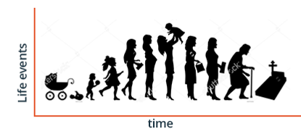
What Happens To Any Process in the Real World?
Creation
Influences Other Processes
Destruction
Influenced by
Other Processes
Stationary for Some Time
Dwindles
Growth
Gives Way to New Processes
Birth
Why Do We We Need to Know What is Happening to the Process?
Picture Copied from https://medium.com/99xtechnology/time-series-forecasting-in-machine-learning-3972f7a7a467

Slide 5
Because We Want to Control the Process or Plan for Eventualities (Trends, Anomalies, Risks, Opportunities)
For Stationary Time Series, All We Need To Do Is To Analyze.
We Can Use Statistical Process Control
Let Us See Some
Examples
But the world changes, its processes change → time series change
Therefore, forecasts for time series are non-trivial → valuable
Changqing Cheng, Akkarapol Sa-Ngasoongsong, Omer Beyca, Trung Le, Hui Yang, Zhenyu (James) Kong & Satish T.S. Bukkapatnam (2015) Time series forecasting for nonlinear and non-stationary processes: a review and comparative study, IIE Transactions, 47:10, 1053-1071, DOI: 10.1080/0740817X.2014.999180

Slide 6
Examples of Processes and Time Series
Acoustic and Electrical Signals from Machines and Structures
Customer Demands and Production Rates
Electricity Load in Smart Grids
Traffic in Telecom and Transportation Networks
Stock Prices and Other Market Indices
EEG, ECG
Temperature and Other Weather Signals
Interactions of Finance, CRM, Manufacturing, Supply Chain, Sales, Human Resources
Changqing Cheng, Akkarapol Sa-Ngasoongsong, Omer Beyca, Trung Le, Hui Yang, Zhenyu (James) Kong & Satish T.S. Bukkapatnam (2015) Time series forecasting for nonlinear and non-stationary processes: a review and comparative study, IIE Transactions, 47:10, 1053-1071, DOI: 10.1080/0740817X.2014.999180

Slide 7
Sources of Change in Dynamics
Trends
Non-stationarity May Not Be
Inherent to the Forecasted Variable
And There is the Issue of Non-Linearity in Processes and Relationships
Changqing Cheng, Akkarapol Sa-Ngasoongsong, Omer Beyca, Trung Le, Hui Yang, Zhenyu (James) Kong & Satish T.S. Bukkapatnam (2015) Time series forecasting for nonlinear and non-stationary processes: a review and comparative study, IIE Transactions, 47:10, 1053-1071, DOI: 10.1080/0740817X.2014.999180

Slide 8
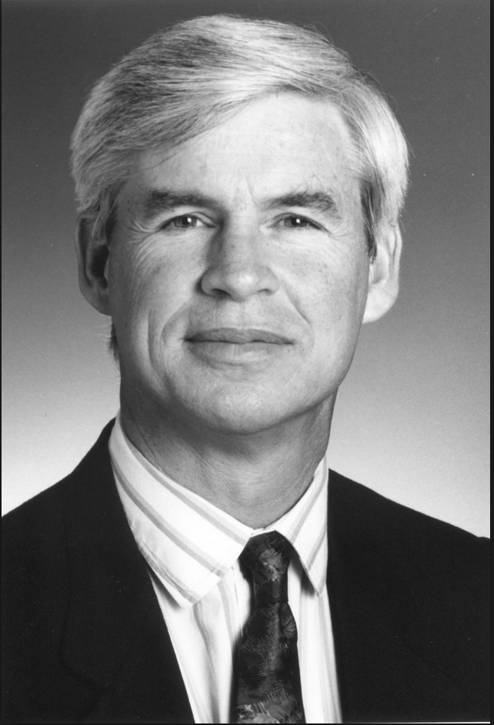
Non-stationary Time Series Forecasting Models
Local Recurrence
Local Markov
Local Gaussian
Dirichlet Process-
Based Mixture Gaussian
Exponential Smoothing
SARIMA(X)
Vector AR (VAR), VECM
ARCH, GARCH
Regime Switching Piecewise Stationary (MRTAR)
GRUs, RNN based Particle Filtering
LSTMs, MV-LSTMs
Wavelets → Autoencoders → LSTMs
CNN+LSTM/RNN+ARIMA
Empirical Mode Decomposition
Many Combinations of These Have Been Explored As Well
Robert F. Engle (born in 1942)
American economist, currently teaches at New York University, Stern School of Business
Changqing Cheng, Akkarapol Sa-Ngasoongsong, Omer Beyca, Trung Le, Hui Yang, Zhenyu (James) Kong & Satish T.S. Bukkapatnam (2015) Time series forecasting for nonlinear and non-stationary processes: a review and comparative study, IIE Transactions, 47:10, 1053-1071, DOI: 10.1080/0740817X.2014.999180

Slide 9
What We Will Talk About…
What We Will Talk About
(S)ARIMA (Seasonal) Auto Regressive Integrated Moving Average
What We Will Not Talk About
Dynamic Mathematical Models Supported By Parameter Sensitivity and Data Driven Models
(G)ARCH (Generalized) Autoregressive Conditional Heteroskedasticity → assumes changing variance of noise (AR or ARMA) with changes in value of variable = Nobel Prize (Engle, 2003)
LSTM (GRU/RNN)
Univariate Models of Time Series
Granger Causality, Co-Integration, Temporal Causal Models = Nobel Prize (Clive, 2003)
What Are Real Sources Of Non-stationarity? What is Possible? What is Not?
How To Model Real World Processes?
Assumes homoskedasticity = variance of error does not depend on value of variable
Notes:
https://www.chaos-math.org/en/chaos-i-motion-and-determinism.html

Slide 10
We Will Also Not Talk About Non-linear Dynamics (Fan and Yao, 2003)
Non-Normality
Aperiodicity
Asymmetric Cycles
Multi-Modality
Non-Linear Causal Relationships Between Lagged Variables
Variation of Forecasting Performance Over the State Space
Time Irreversibility (Which is True for Nearly Everything)
We Will Discuss These Another Day
Changqing Cheng, Akkarapol Sa-Ngasoongsong, Omer Beyca, Trung Le, Hui Yang, Zhenyu (James) Kong & Satish T.S. Bukkapatnam (2015) Time series forecasting for nonlinear and non-stationary processes: a review and comparative study, IIE Transactions, 47:10, 1053-1071, DOI: 10.1080/0740817X.2014.999180

Slide 11
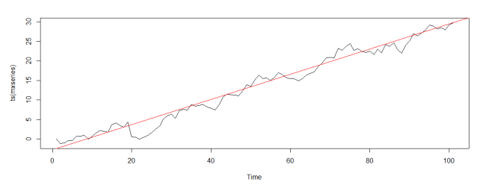
Trend = Equivalent to a Linear Change
Trend is component of time series that represents variations of low frequency
Source: www.oraylis.de/blog/trend-in-times-series-analysis

Slide 12
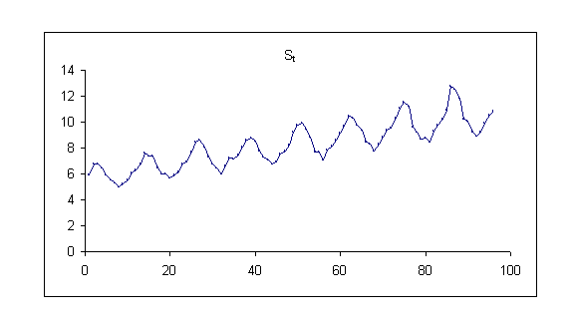
Seasonality = Equivalent to Dependence on Past Values
Seasonality is component of time series that represents intra year fluctuations.
More or less stable year after year (or the relevant time period chunk)
Source: www.epixanalytics.com/modelassist/AtRisk/Model_Assist.htm#Time_series/Seasonal_time_series.htm

Slide 13
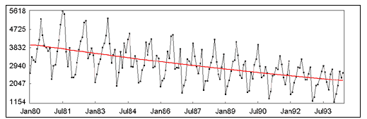
Trend + Seasonality
Source: http://www.gistatgroup.com/cat/examples/ex_1_4.html

Slide 14
What is Stationarity?

Slide 15
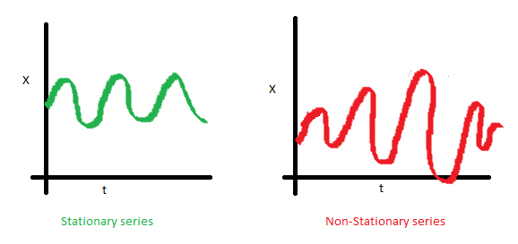
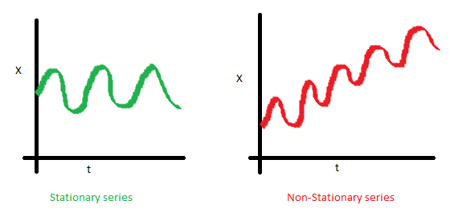
Stationary Series
Constant Mean
Constant Variance
Why do we care about Stationarity in Time Series Forecasting?
Because That Lets Us Use Simpler Models

Slide 16
Strict Stationarity

Slide 17
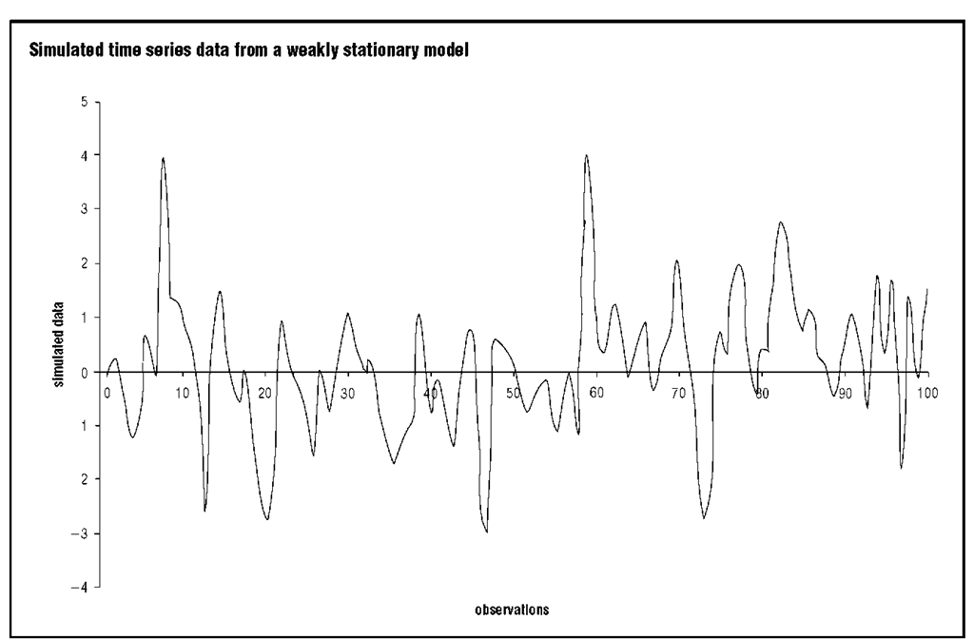
Types of Stationarity - 1
Strict stationarity means that the joint distribution of any moments of any degree (e.g. expected values, variances, third order and higher moments) within the process is never dependent on time.
This definition is in practice too strict to be used for any real-life model.
First-order stationarity series have means that never change with time.
Any other statistics (like variance) can change.
Second-order stationarity (also called weak stationarity) time series have a constant mean, variance and an autocovariance that doesn’t change with time.
Other statistics in the system are free to change over time. This constrained version of strict stationarity is very common.

Slide 18
Mean and Variance Do Not Change in Time

Slide 19
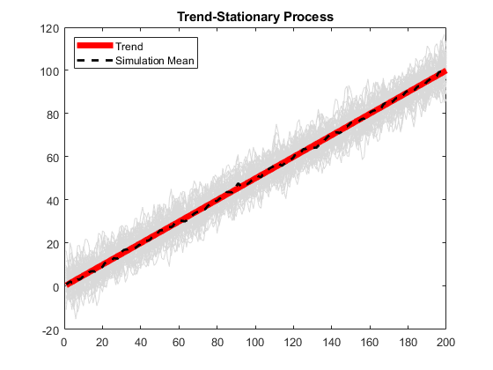
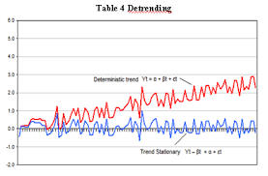
Types of Stationarity - 2
Trend-stationary series fluctuate around a deterministic trend in the series mean.
These deterministic trends can be linear or quadratic, but the amplitude (height of one oscillation) of the fluctuations neither increases nor decreases across the series.
KPSS (Kwiatkowski–Phillips–Schmidt–Shin) Test

Slide 20
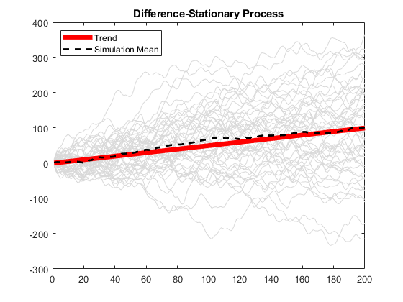
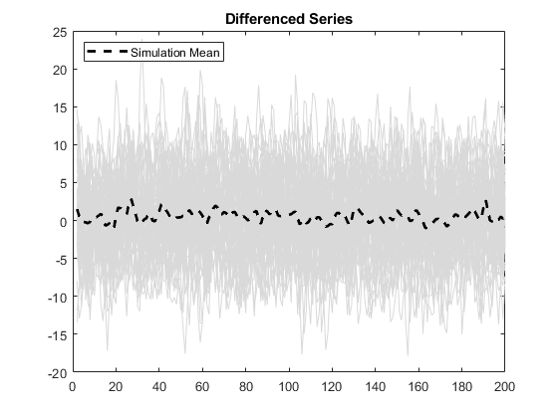
Types of Stationarity - 2
Trend-stationary series
(aka Difference stationary)
need one or more differencing steps to become stationary
(n^{th} order Integrative)
Differencing and then Dickey Fuller Test or KPSS
Think of
v=u+at
s=s₀+ut+0.5at²

Slide 21
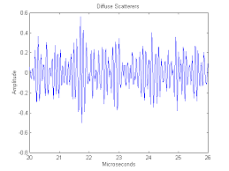
Types of Stationarity – 3 (Beyond Today’s Scope)
Cyclo-stationary series (unseasonal longer cycles) are equivalent to two or more interleaved stationary processes

Slide 22
Claim: One Cannot Find a Real World Process Which is Stationary, Left to Itself
If we can, then we have found an exception to the Second Law of Thermodynamics
If we can’t, we are stuck dealing with non-stationary processes!
Generally, only carefully controlled and maintained processes are stationary.
There is no known physical process in the world of matter which depends only on itself.
Stationary processes give the illusion of being predictable from their previous states simply because there is a controlling and maintaining mechanism, which is expected to be predictable ☺
Or it is over a relatively short period of time

Slide 23
Time Series Forecasting Requires a Model

Slide 24
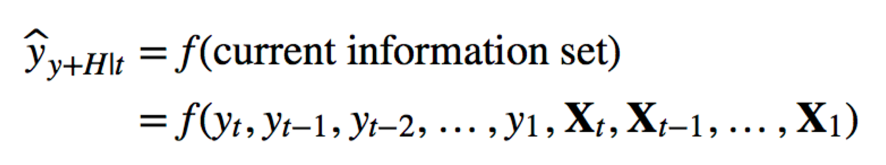
Time Series Forecasting Requires Models
10

Slide 25
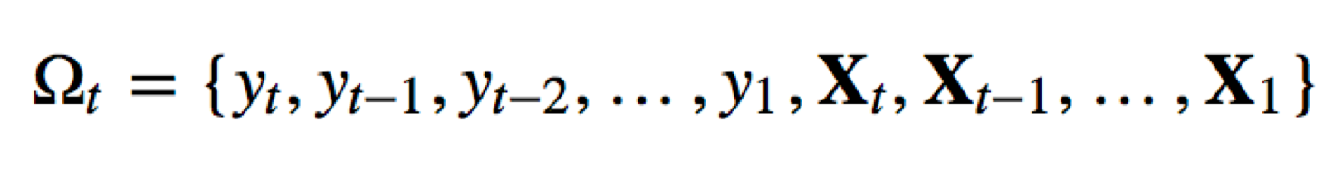
Time Series Forecasting Requires Models
Forecast horizon: H
A statistical model or a machine learning algorithm
Information Set:

Slide 26
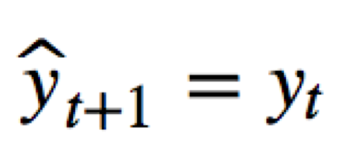
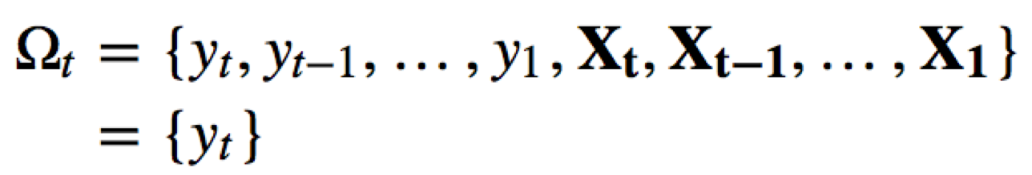
A Naïve, Rule-based Model:
A model, f(), could be as simple as “a rule” - naive model:
The forecast for tomorrow is the observed value today
Information Set:
Forecast horizon: h=1

Slide 27
However …
The function f( ) could be a
slightly more complicated “model”
that utilizes more information
from the current information set

Slide 28
In Short, The Next Step is a Weighted Sum (Not Average)
of 1 or More Previous Steps.

Slide 29
model = ARIMA(ts_log, order=(2, 1, 0))
Notes:
model = ARIMA(ts_log, order=(2, 1, 0))

Slide 30
In Short, a Weighted Sum of The Shock or Noise or Error from The Past
Determines the Next Steps

Slide 31
model = ARIMA(ts_log, order=(0, 1, 2))

Slide 32
The Sample Autocorrelation Function
The first order (or lag 1) autocorrelation measures the correlation between successive observations in a time series.
The sample value is computed as:

Slide 33
The Sample Autocorrelation Function
Higher order autocorrelations: The sample function for lag k is:
The plot of r_{k} against k for k=1,2,… is known as the sample autocorrelation function (ACF), typically plotted for the first n/4 lags or thereabouts.
The plot is supplemented with 5% significance limits to enable a graphical check of whether dependence exists at a given lag.

Slide 34
ACF (Auto Correlation Function) and PACF (Partial Autocorrelation Function)
5% Significant Limit
5% Significant Limit
Number of Time Shifts
Number of Time Shifts
A Moving Average Process of Second Order

Slide 35
An Auto Regressive Process of Second Order

Slide 36
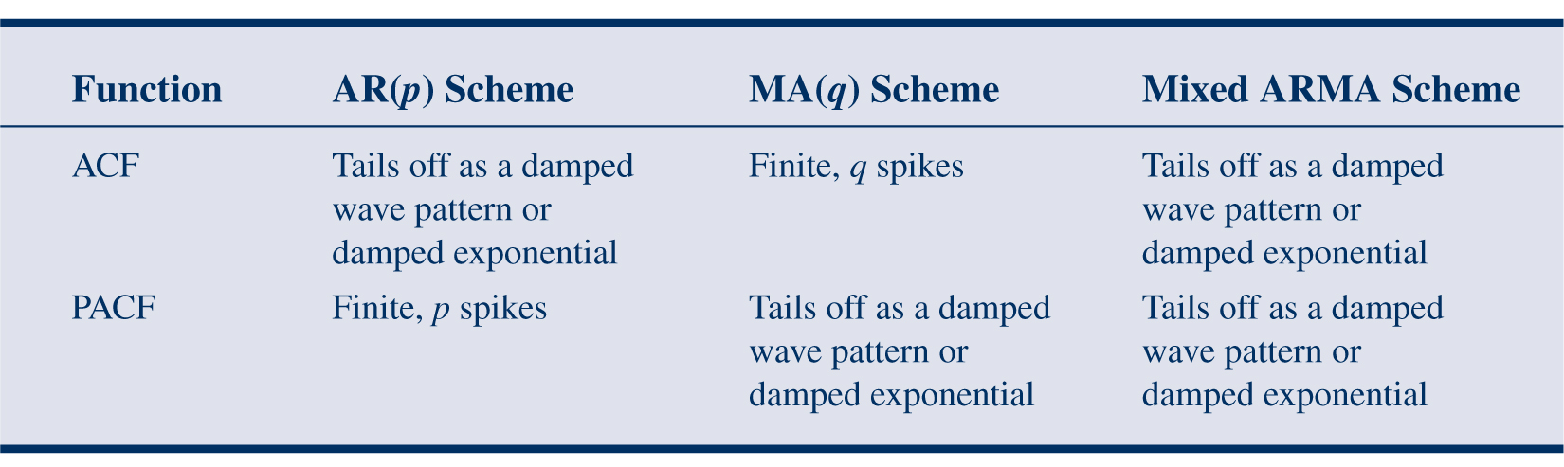
Partial Autocorrelations and Model Selection

Slide 37
In other words, it is linear combination of

Slide 38
p, d, q
(Shock/error term)
Let Us Look at A Recent Article on Analytics Vidhya

Slide 41
Unit Root Test for Non-Stationarity
Each Process Has a Characteristic Function
Recall when we used to solve polynomial equations or differential equations
If Characteristic Function Has Root = 1, Then Process is Non-Stationary = Variance Increases in Time (Permanent Shift on Shocks)
If Process Has Root >1, It is an Explosive Process
If all other roots are less than 1, then the first difference/derivative of the process will be weak stationary. If there are n unity roots, then n differences/derivatives are required to get weak stationarity
Notes:
Consider the first-order autoregressive process
Xt=aXt−1+etXt=aXt−1+et
where etet is white noise. The model can also be expressed with all XX's on one side asXt−aXt−1=et.Xt−aXt−1=et.
Using the backshift operator BXt=Xt−1BXt=Xt−1 we can re-express the model compactly as Xt−aBXt=etXt−aBXt=et or, equivalently,
(1−aB)Xt=et.(1−aB)Xt=et.
The characteristic polynomial is 1−ax1−ax. This has a (unique) root at x=1/ax=1/a. Then for |a|<1|a|<1 we have a stationary AR(1)AR(1) process and for |a|>1|a|>1 we have an explosive nonstationary AR(1)AR(1)process. For a=1a=1 we have a random walk which is nonstationary and a unit root x=1/1=1x=1/1=1. So the unit roots form the boundary between stationarity and nonstationarity. The AR(1)AR(1) model (by virtue of its linear characteristic polynomial) is the simplest to illustrate it.
the characteristic equation (or auxiliary equation^{[1]}) is an algebraic equation of degree n upon which depends the solution of a given nth-order differential equation^{[2]} or difference equation.^{[3][4]} The characteristic equation can only be formed when the differential or difference equation is linear and homogeneous, and has constant coefficients.^{[1]} Such a differential equation, with y as the dependent variable, superscript (n) denoting n^{th}-derivative, and a_{n}, a_{n − 1}, ..., a₁, a₀ as constants,

Slide 42
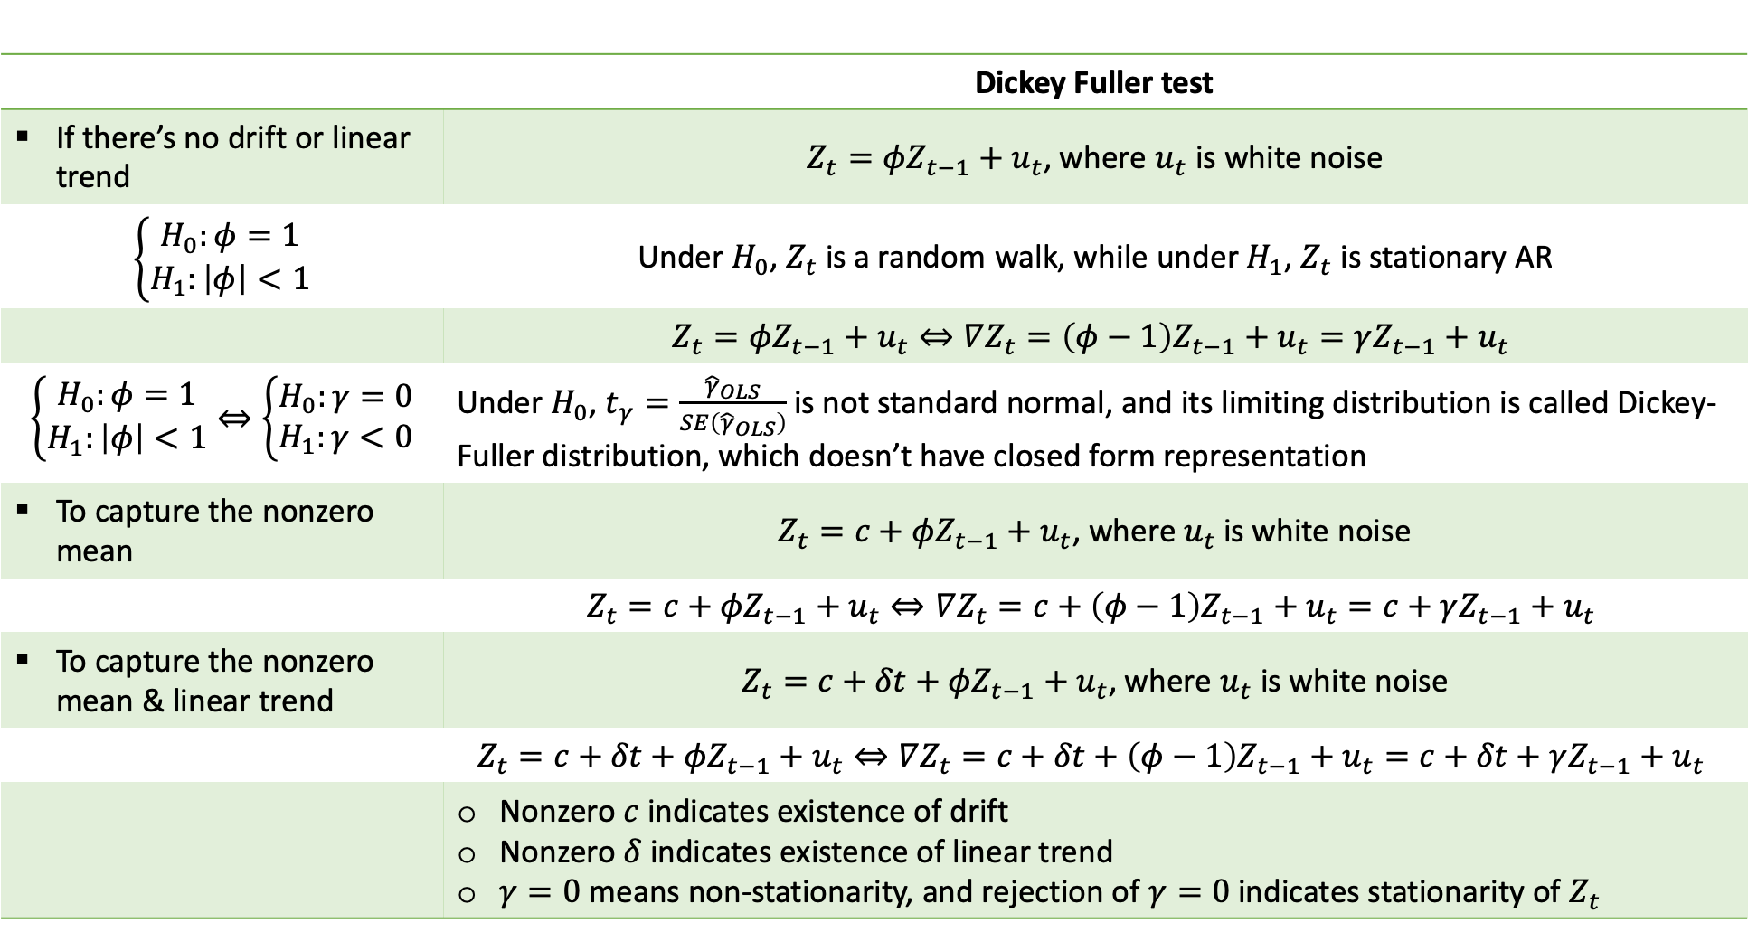
 | Dickey Fuller test
If there’s no drift or linear trend
To capture the nonzero mean
To capture the nonzero mean & linear trend

Slide 43
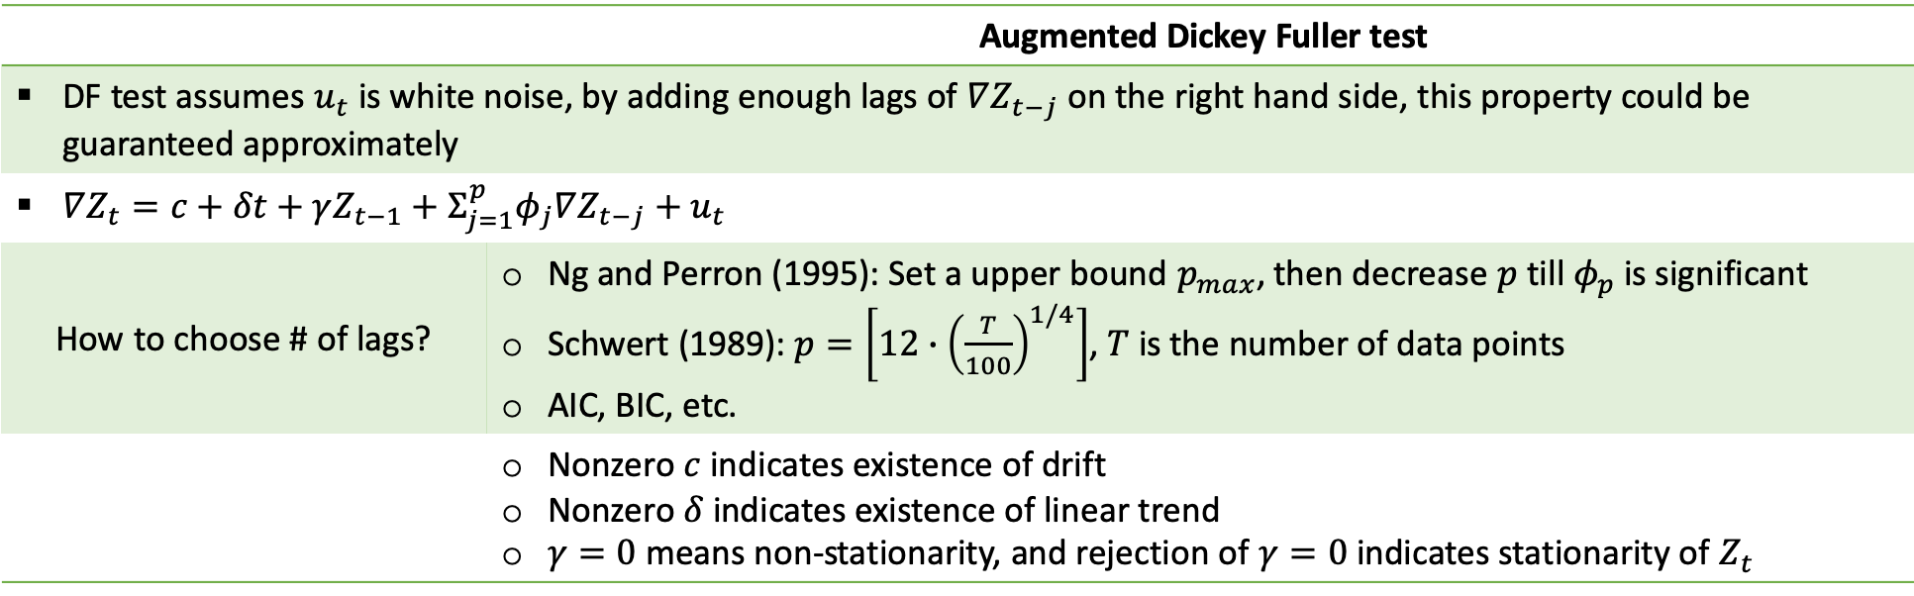
 | Augmented Dickey Fuller test
How to choose # of lags?

Slide 44
Test | What we are testing? | Null hypothesis | Alternative hypothesis | Critical values
Sequential testing | last lag p of time series has influence to model | No influence | Has influence | p-values
Ljung-Box test | Autocorrelation of residuals | No autocorrelation | Autocorrelation exists | p-values
Mc Leod Li test | Heteroskedasticity of residuals | Homoskedasticity | Heteroskedasticity | p-values
Dickey-Fuller | Unit roots | Unit root exists | No unit root | H0 rejected, if test result < critical value
Augmented Dickey-Fuller | Cointegration of time series | No cointegration | Cointegration exists | H0 rejected, if test result < critical value
Johansen Procedure | Cointegration rank | No cointegration at rank r | Cointegration at rank r | Start from r=0 and stop when test statistic < critical value

Slide 45
Fractional Integration

Slide 46
Selection of Techniques Beyond ARIMA
Changqing Cheng, Akkarapol Sa-Ngasoongsong, Omer Beyca, Trung Le, Hui Yang, Zhenyu (James) Kong & Satish T.S. Bukkapatnam (2015) Time series forecasting for nonlinear and non-stationary processes: a review and comparative study, IIE Transactions, 47:10, 1053-1071, DOI: 10.1080/0740817X.2014.999180

Slide 47
For Background Information Please See
https://www.analyticsvidhya.com/blog/2018/02/time-series-forecasting-methods/
https://www.analyticsvidhya.com/blog/2016/02/time-series-forecasting-codes-python/

Slide 48
Backup

Slide 49
Why Multi-Variate?

Slide 50
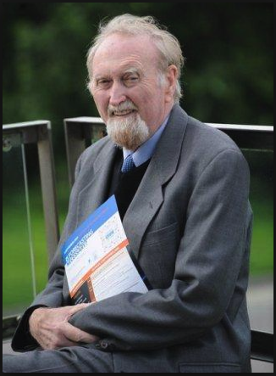
Why Do We Need to Handle Multiple Time Series?
In the real world, each process is an outcome of
A (non)linear combination of relationships between multiple processes
With mutual delays and shock events
Non-Stationarity in a single time series may be simply a cointegration of multiple time series
Nobel Prize awarded to Clive Granger in 2003 for this insight in econometrics
Well-known in statistics for many years
Clive Granger (1934 – 2009)
British economist, taught at University of Nottinghan in Britain & University of California, San Diego in US

Slide 51
Problem with Differencing or Integration to Use Methods Meant for Stationary Processes
Works Well for One-Two Levels, I(1)/I(2)
After Second Level, Risk of Chaotic Behavior
Apparent Non-Stationarity Could Be Due to Contributing Variables
There May Be a Cointegration With Causative Variables That Removes Non-Stationarity

Slide 52
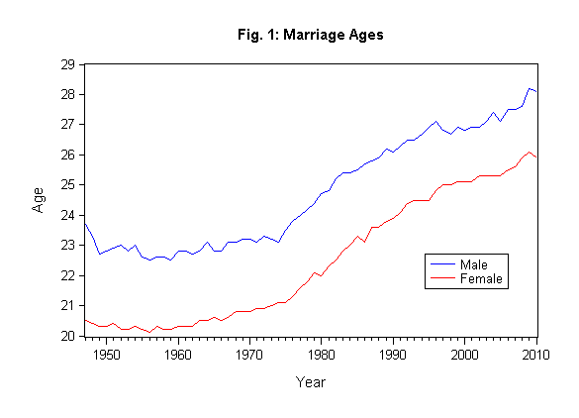
Cointegration
Two cointegrated time series follow the same long-run path
Multiplying β with any non-zero constant is also cointegration vector
All linear combinations of β are also co-integrating vectors

Slide 53
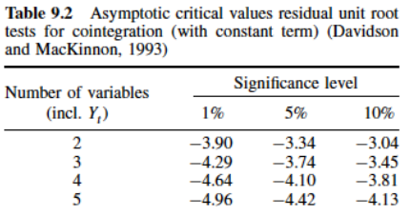
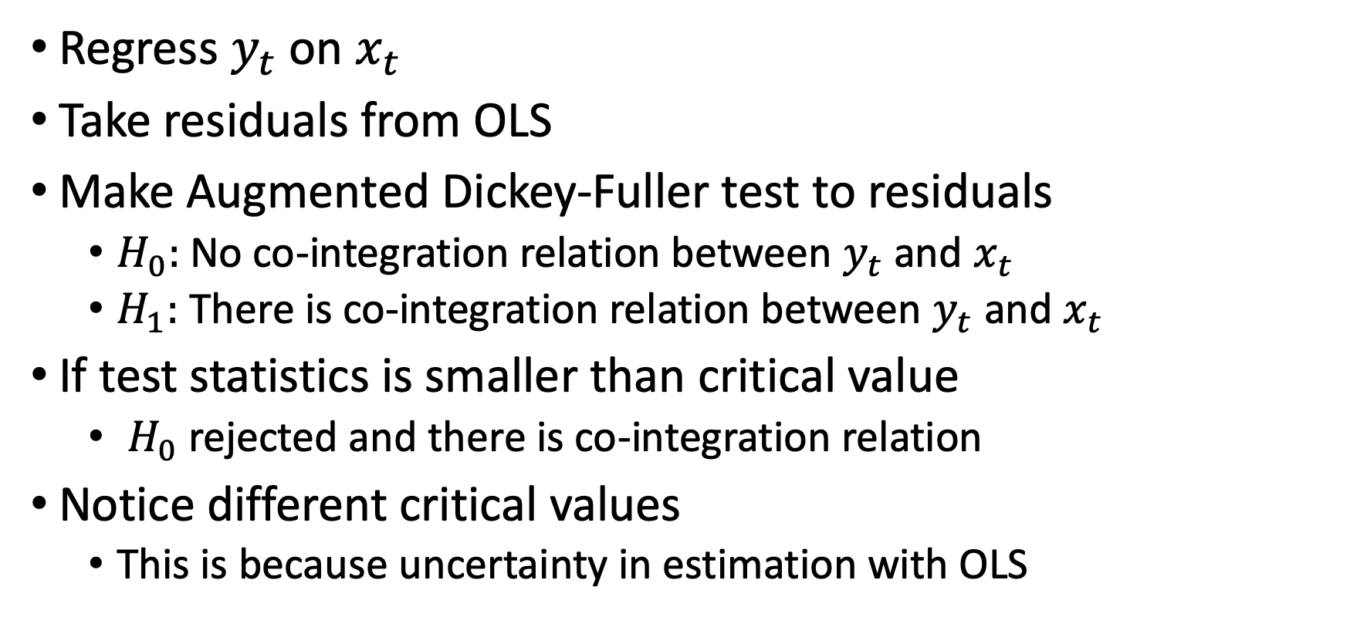
Testing for Cointegration

Slide 54
Why Do We Need to Handle Multiple Time Series?
Give an example of a real world process that affects other things, but is not affected by anything else
This is one of the assumptions of a univariate time series model - this process is affected only by its own past states.
In Real World, There are Real Relationships Between Processes
There is Nothing in an Enterprise that Works on Its Own
Imagine Sales Not Being Dependent on Demand or Supply or Marketing or Production
Only true for accumulative processes, when we are not modeling what produces the accumulating quantity, and are not looking to directly influence it.

Slide 55
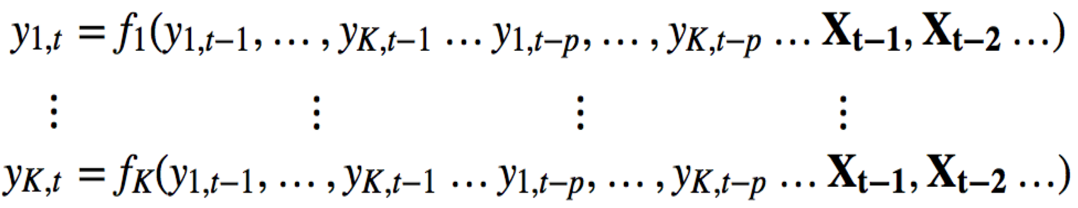
Multivariate Time Series Modeling
lag-1 of the K series
exogenous series
K equations
lag-p of the K series
Interdependence among the series
Dynamics of each of the series

Slide 56
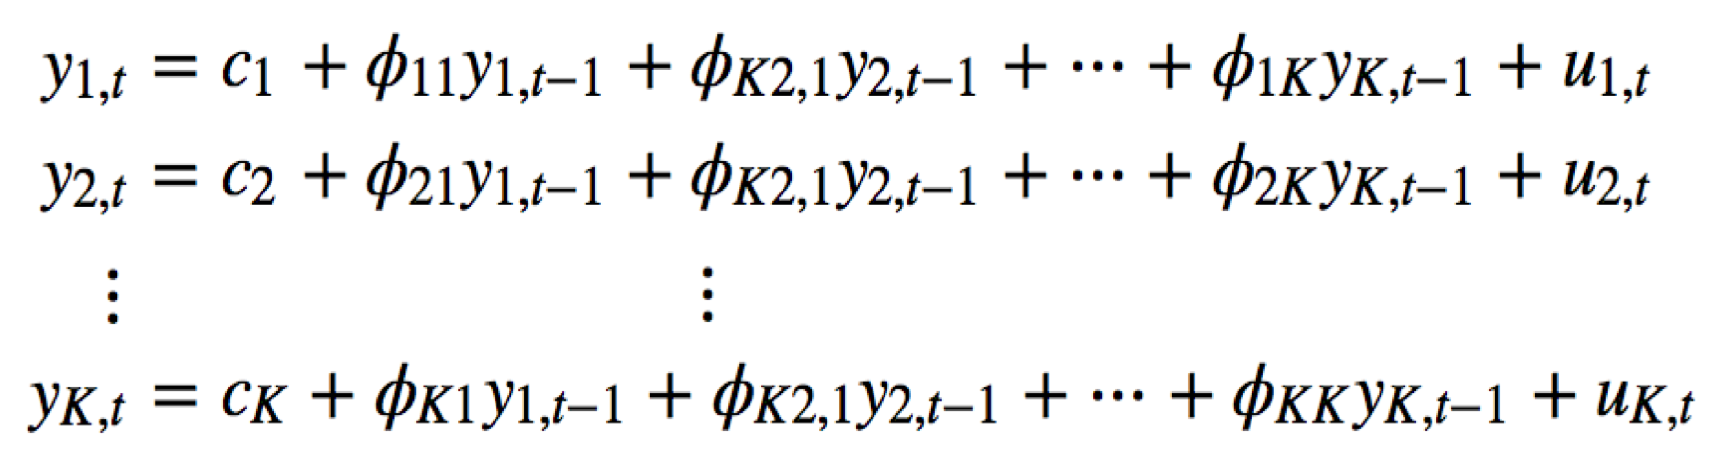
Vector Autoregressive (VAR) Model of Order 1
A system of K equations
Each series is modeled by its own lag as well as other series’ lags

Slide 57
Vector Autoregressive (VAR) Models
A system of linear equations of the K series being modeled
Only applies to stationary series
Non-stationary series can be transformed into stationary ones using differencing
If the multiple series are not co-integrated, then we can still apply VAR ("VAR in differences")
https://www.analyticsvidhya.com/blog/2018/09/multivariate-time-series-guide-forecasting-modeling-python-codes/

Slide 61
Thank You

